Slide 1
Introduction

Slide 2
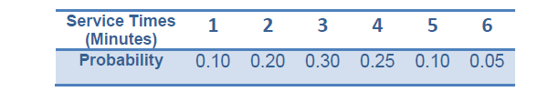
Generating Stochastic Variables
Let’s assume customer’s service time follow discrete distribution:
We don’t exactly know the service time of the next customer, but we can predict.
We predict according to the distribution, it is either 1,2,3,4,5,6 mins.

Slide 3
Generating Stochastic Variables
We have to get cumulative distribution function to represent the probabilities distribution.
and then generate a random number in range [0-1[ =>x
Find the service time (X) that has cumulative probability greater than or equal to x (this is why x has to belong to [0-1[ )
Notes:
In simulation, events usually occur at random times, the randomness imitating uncertainty in real life.
Random numbers are distributed uniformly and independently on the interval (0, 1).
In probability theory and statistics, the cumulative distribution function (CDF), or just distribution function, describes the probability that a real-valued random variable X with a given probability distribution will be found at a value less than or equal to x.

Slide 4
Example

Slide 5
Generation
Using the following sequence of uniform random generated numbers, generate service time for 6 customers.
Service Time | Probability | Cumulative Probability
1 | 0.10 | 0.10
2 | 0.20 | 0.30
3 | 0.30 | 0.60
4 | 0.25 | 0.85
5 | 0.10 | 0.95
6 | 0.05 | 1
Random Number | Service Time
0.28
0.09
0.5
0.19
0.02
0.75
Service-Time Distribution

Slide 6
Generation
Using the following sequence of uniform random generated numbers, generate service time for 6 customers.
Random Number | Service Time
0.28 | 2
0.09 | 1
0.5 | 3
0.19 | 2
0.02 | 1
0.75 | 4
Service Time | Probability | Cumulative Probability
1 | 0.10 | 0.10
2 | 0.20 | 0.30
3 | 0.30 | 0.60
4 | 0.25 | 0.85
5 | 0.10 | 0.95
6 | 0.05 | 1
Service-Time Distribution

Slide 7
Generation
Using the following sequence of uniform random generated numbers, generate inter-arrival times for 6 customers.
Random Number | Inter-arrival Time
0.2
0.4
0.1
0.17
0.7
0.8
Inter-arrival Time | Probability | Cumulative Probability
1 | 0.125 | 0.125
2 | 0.125 | 0.250
3 | 0.125 | 0.375
4 | 0.125 | 0.500
5 | 0.125 | 0.625
6 | 0.125 | 0.750
7 | 0.125 | 0.875
8 | 0.125 | 1.000
Distribution of Time Between Arrivals

Slide 8
Generation
Using the following sequence of uniform random generated numbers, generate inter-arrival times for 6 customers.
Random Number | Inter-arrival Time
0.2 | 2
0.4 | 4
0.1 | 1
0.17 | 2
0.7 | 6
0.8 | 7
Inter-arrival Time | Probability | Cumulative Probability
1 | 0.125 | 0.125
2 | 0.125 | 0.250
3 | 0.125 | 0.375
4 | 0.125 | 0.500
5 | 0.125 | 0.625
6 | 0.125 | 0.750
7 | 0.125 | 0.875
8 | 0.125 | 1.000
Distribution of Time Between Arrivals

Slide 9
Example
Simulation Table Emphasizing Clock Times
Customer Number | Inter-Arrival Time | Arrival Time (Clock) | Time Service Begins (Clock) | Service Time (Duration) | Time Service Ends (Clock)
1 | _ | 0 | 0 | 2 | 2
2 | 2 | 2 | 2 | 1 | 3
3 | 4 | 6 | 6 | 3 | 9
4 | 1 | 7 | 9 | 2 | 11
5 | 2 | 9 | 11 | 1 | 12
6 | 6 | 15 | 15 | 4 | 19

Slide 10
Graph
Arrival of customer 1 Being served Departure of customer 1
t
e1

Slide 11
Graph
Arrival of customer 2 Being served Departure of customer 2
t
e1
e2

Slide 12
Graph
Server Idle
t
e1
e2

Slide 13
Graph
Arrival of customer 3 Being served
t
e1
e2
e3

Slide 14
Graph
Arrival of customer 4 Wait in the queue Departure of customer 3
t
e1
e2
e3
e4

Slide 15
Graph
Start Serving customer 4
t
e1
e2
e3
e4

Slide 16
Graph
Arrival of customer 5 Wait in the queue Departure of customer 4
t
e1
e2
e3
e4
e5

Slide 17
Graph
Start serving customer 5 Departure of customer 5
t
e1
e2
e3
e4
e5

Slide 18
Graph
Server Idle
t
e1
e2
e3
e4
e5

Slide 19
Graph
Arrival of customer 6 Being served
t
e1
e2
e3
e4
e5
e6

Slide 20
Graph
Departure of customer 6
t
e1
e2
e3
e4
e5
e6

Slide 21
Multi-channel Queue
Project 1 - The Call center

Slide 22


Multi-channel Queue
Baker
Able

Slide 23

Multi-channel Queue

Slide 24
Multi-channel Queue
Baker
Able

Slide 25
Multi-channel Queue

Slide 26

Multi-channel Queue
Baker
Able

Slide 27
Multi-channel Queue

Slide 28
Multi-channel Queue
Baker
Able

Slide 29
Multi-channel Queue - Arrival of a Customer
Arrival Event
Is Able Idle?
Yes
Customer enters service
No
Customer enters queue for service
No
Is Baker Idle?
Yes
Customer enters service
Unit-entering-system flow diagram

Slide 30
Multi-channel Queue - Departure of a Customer
Departure Event
Begin server idle time
No
Another customer waiting?
Yes
Remove the waiting customer from the queue
Begin servicing the customer
Service-just-completed flow diagram

Slide 31
Multi-channel Queue
estimate the system measures of performance in terms of:
The efficiency of Able.
The efficiency of Baker
The average caller delay.

Slide 32
Multi-channel Queue - System Design
Server Selection:
Highest Priority
Each server should be assigned a priority
When a customer arrives, it enters the available server having the highest priority
Random
Choose any server of the available servers
Lowest utilization
When a customer arrives, calculate the utilization of the available servers (idle)
The customer enters the server having the lowest utilization, i.e. the server that worked the least amount of time since the system has started running.

Slide 33
Multi-channel Queue - System Design
System Variables
t_{i}= arrival time i
A_{i} = t_{i} – t_{i-1} inter-arrival time
s_{i}= service time i
D_{i}= waiting time i
C_{i} = t_{i} + D_{i} + s_{i} = departure time i
e_{j} = time event j
s and A are stochastic variables

Slide 34
Multi-channel Queue - System Input
Inter-arrival time distribution (user enters distribution type and parameters)
Number of servers
Service time distribution for each server
Server Selection method (highest priority, lowest utilization, random)
Stopping Condition (Number of customers at which to stop the simulation, Simulation end time)

Slide 35
Multi-channel Queue - System Output
Results table
Having these columns: Customer No., Inter-arrival time, Arrival time, Server Index, Time Service Begins , Service duration, Time Service Ends (Departure), total delay time for this customer
Assume Server 1 has higher priority

Slide 36
Multi-channel Queue - System Output
Interarrival Distribution of calls
Interarrival Time | Probability | Cumulative probability | Rang
1 | 0.25 | .25 | 0-25
2 | 0.4
3 | 0.2
4 | 0.15

Slide 37
Multi-channel Queue - System Output
Able’s Service Time distribution
Service Time | Probability | Cumulative probability | Rang
2 | 0.3
3 | 0.28
4 | 0.25
5 | 0.17

Slide 38
Multi-channel Queue - System Output
Baker’s Service Time distribution
Service Time | Probability | Cumulative probability | Rang
3 | 0.35
4 | 0.25
5 | 0.20
6 | 0.20

Slide 39
Multi-channel Queue - System Output
Results Table
Cust. No. | Inter-arrival time | Arrival Time | Server Index | Time Service Begins | Service Duration | Time Service Ends | Total Delay
1 | 0 | 2 | 1 | 2 | 4 | 6 | 0
2 | 3 | 5 | 2 | 5 | 3 | 8 | 0
3 | 5 | 10 | 1 | 10 | 6 | 16 | 0
4 | 2 | 12 | 2 | 12 | 2 | 14 | 0
5 | 1 | 13 | 2 | 14 | 3 | 18 | 1
6 | 2 | 15 | 1 | 16 | 3 | 19 | 1
7 | 1 | 16 | 2 | 18 | 1 | 19 | 2
8 | 3 | 19 | 1 | 19 | 1 | 20 | 0

Slide 40
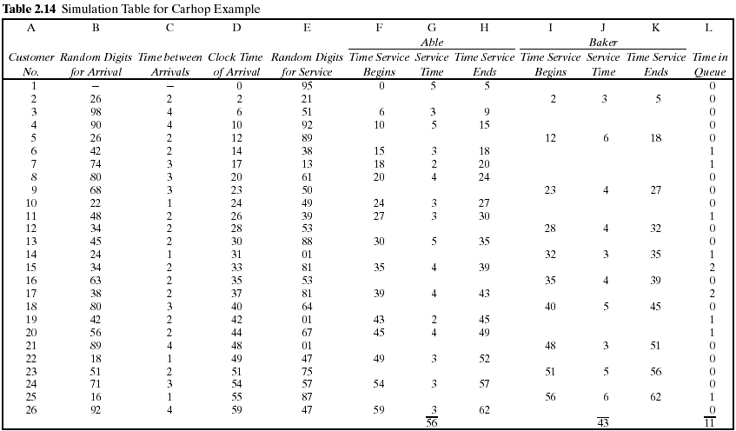
Multi-channel Queue - System Output

Slide 41
System Output
Calculate the Measures of Performance:
Average service time per server.
Average waiting time (in the queue).
Maximum queue length.
Probability that a customer wait in the queue.
Utilization of each server or The portion of idle time of the server.
Do we need extra server? Why?!!

Slide 42
System Output
Measure system performance by calculating the following variables:
Notes:
Total number of customers : number of customers that have entered the server
Total time customers waited in queue : the sum of delay time of the customers that entered the server
Number of customers who waited: number of customers that have entered the server and having delay time > 0

Slide 43
Multi-channel Queue – Graph
Required Charts
Customers Queue Graph
X-axis : time
Y-axis : Q(t), number of customer in queue
Queue Size Histogram
X-axis : delay time duration (0 mins, 1 min, 2 mins, …)
Y-axis : number of customers that has total delay = delay time
Ex. X = 2 mins, Y = number of customers that stayed in the queue for 2 mins
Server Busy Time (Bonus)
X-axis : time
Y- axis : it has a value of 1 if the server is busy or zero if the server is idle

Slide 44
Customers Queue Graph

Slide 45
Queue Size Histogram

Slide 46
Server Busy Time – Server 1

Slide 47
Server Busy Time – Server 2

